Slide 1

Linear and Logistic Regression Workshop
Yong Hao and Philip
This Photo by Unknown author is licensed under CC BY-NC.

Slide 2
Objective
Introduction to basic machine learning models:
Linear Regression
Feature Engineering
Logistic Regression
Problem Solving with Predictor Variables
Establish Foundation for Future Workshops

Slide 3
Supervised Learning
VS
Unsupervised Learning
Parameters | Supervised machine learning technique | Unsupervised machine learning technique
Process | Input and output variables given | Only input data given
Input Data | Algorithms trained using labelled data | Algorithms used against unlabelled data
Algorithms Used | Support vector machine, neural network, linear and logistic regression, random forest, classification trees | Cluster algorithms, K-means, hierarchical clustering
Computational Complexity | Simpler | Computationally complex
Accuracy of Results | Highly accurate and trustworthy method | Less accurate and trustworthy method
Real-Time Learning | Learning takes place offline | Learning takes place in real time
Number of Classes | Known | Not known

Slide 4
Supervised learning main pipeline
Test Data
Data Acquisition
Data Exploration and Preparation
Model Building & Training
Model Testing
Model Deployment

Slide 5
Linear Regression

Slide 6
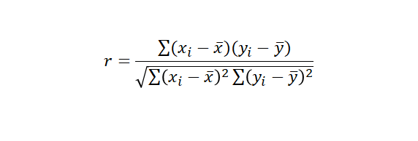
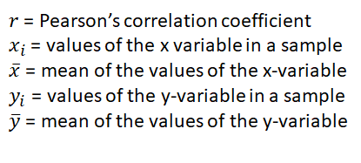
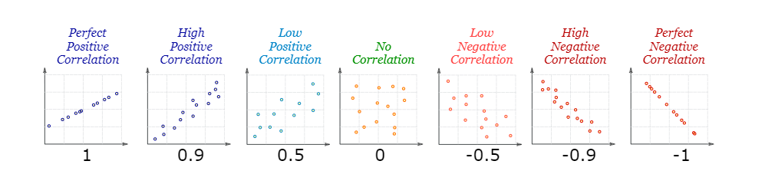
Correlation
Source: https://www.mathsisfun.com/definitions/correlation.html

Slide 7
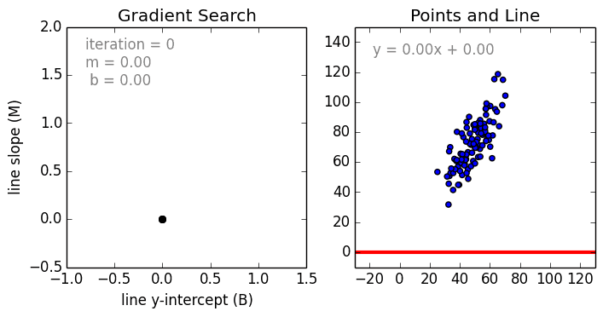
Linear Regression
Data is modelled with a straight line
Takes continuous data as input and generates the corresponding output which is also continuous data
Applications:
Predictions:
the outcome of political elections
the behavior of the stock market
the performance of a professional athlete
Correlation:
effects of a proposed drug on the patients in a controlled study
Source: https://techburst.io/introduction-to-linear-regression-bd7f834d0255

Slide 8
Simple Linear Regression
A statistical method used to summarize and study relationships between two continuous (quantitative) variables:
One variable, denoted x, is regarded as the predictor, explanatory, or independent variable.
The other variable, denoted y, is regarded as the response, outcome, or dependent variable.
"simple" as it only uses one predictor variable.
Weight, X (kg) | Height, Y (cm)
50 | 150
60 | 180
70 | 175

Slide 9
Pop Quiz
If we are trying to predict the sales of Chef Ramsay’s steak based on weather, which variables are the predictor variable(s)?
A. Weather
B. Steak Sales
C. Weather and Steak Sales
D. Chef Ramsay’s Hat

Slide 10
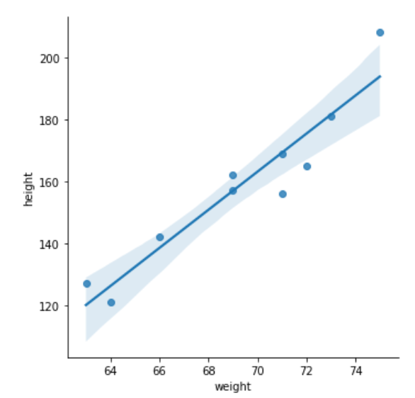
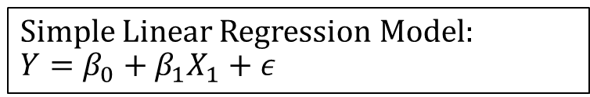
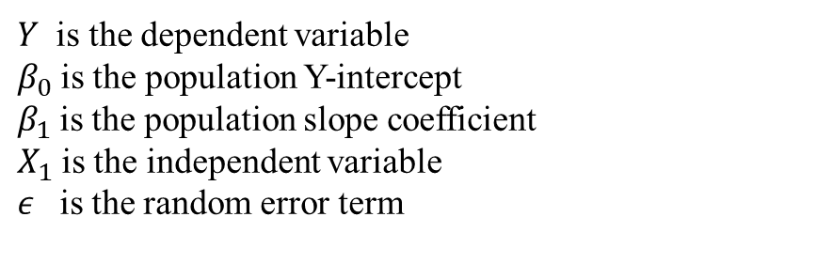
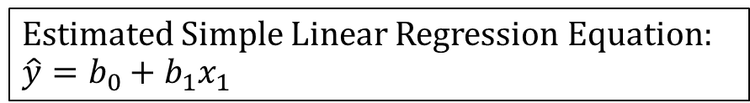
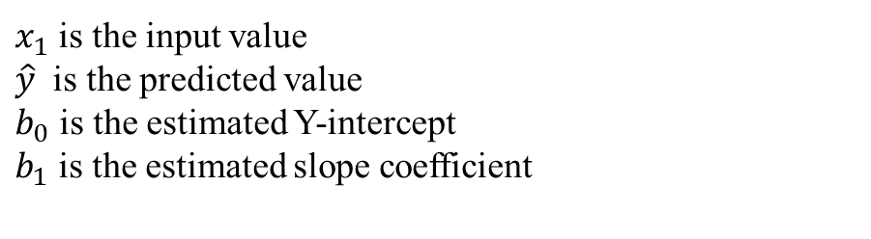
Simple Linear Regression

Slide 11
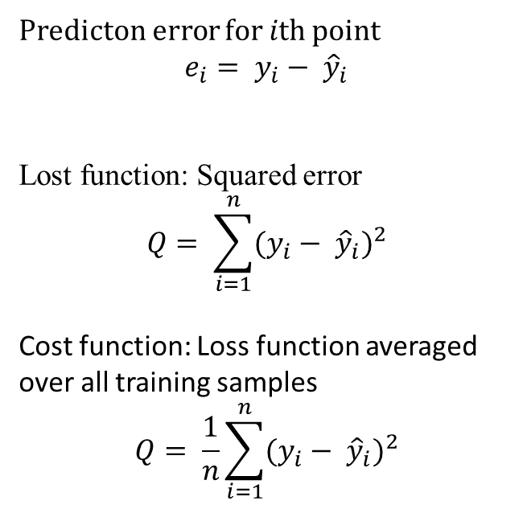
Simple Linear Regression

Slide 12
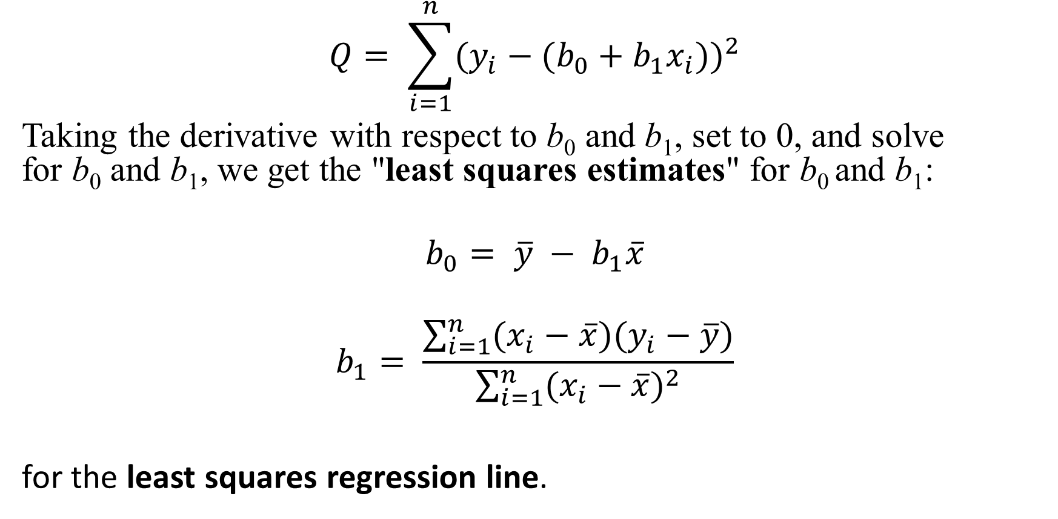
Simple Linear Regression Formula

Slide 13


The Normal Equation
The more efficient way to implement the formula is by using matrices, bringing us to the normal equation
An effective and a time-saving option when are working with a dataset with small features.
It involves matrix inversion which is O(n^3) which is not scalable when we are dealing with large features

Slide 14
Gradient Descent Algorithm
An iterative optimization algorithm to find the minimum of a function.
It is O(n)
Loss
Initial Position
Final Position
Weight/Bias

Slide 15
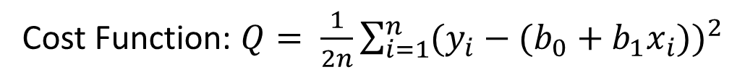
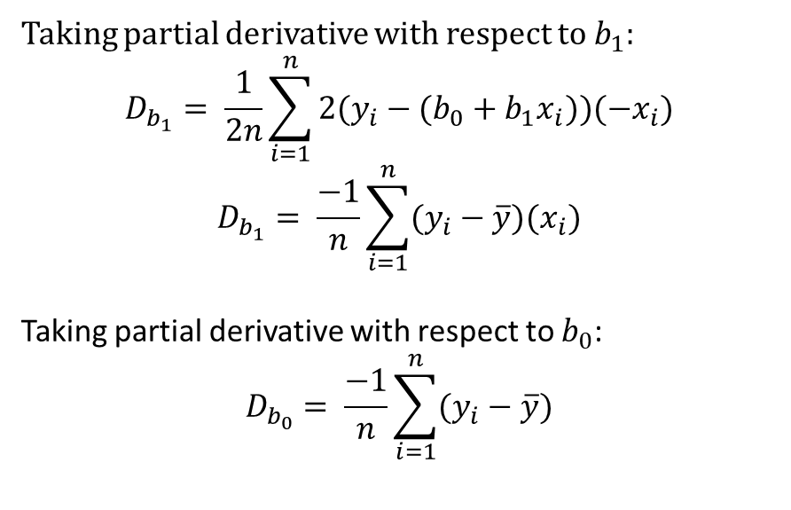
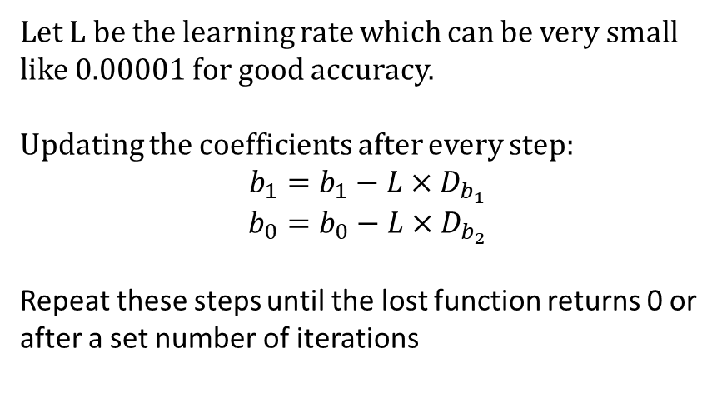
Gradient Descent Algorithm
Notes:
In both gradient descent (GD) and stochastic gradient descent (SGD), you update a set of parameters in an iterative manner to minimize an error function.
While in GD, you have to run through ALL the samples in your training set to do a single update for a parameter in a particular iteration, in SGD, on the other hand, you use ONLY ONE or SUBSET of training sample from your training set to do the update for a parameter in a particular iteration. If you use SUBSET, it is called Minibatch Stochastic gradient Descent.
Thus, if the number of training samples are large, in fact very large, then using gradient descent may take too long because in every iteration when you are updating the values of the parameters, you are running through the complete training set. On the other hand, using SGD will be faster because you use only one training sample and it starts improving itself right away from the first sample.
SGD often converges much faster compared to GD but the error function is not as well minimized as in the case of GD. Often in most cases, the close approximation that you get in SGD for the parameter values are enough because they reach the optimal values and keep oscillating there.

Slide 16
Learning Rate
Too Small
Too Big
Loss
Loss
Weight/Bias
Weight/Bias
Converge very slowly
Overshoot or even diverge

Slide 17
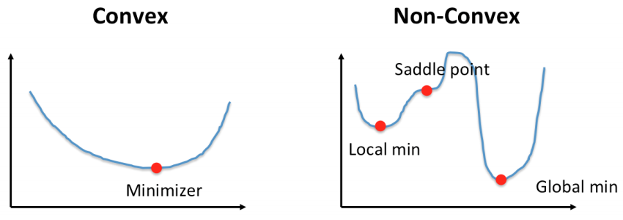
Convex and Non-convex Functions
Linear Regression
Logistic Regression
Source: https://pl.pinterest.com/pin/672232681861372201/
Features of a convex function
Local minima = global minima
The line segment between any 2 points on the graph lies above the graph and does not intersect the graph other than the 2 points
Gradient Descent (or any other optimization algorithm is guaranteed to find the minimum only for convex functions (if the learning rate is not too large and it went through enough iterations).

Slide 18
Pop Quiz
What is the cost function used for linear regression model optimization?
A. Mean Absolute Error
B. Sum of Errors
C. Mean Squared Error
D. Mean Error
Mean squared error is used to ensure that all errors are accounted for and penalise the larger errors

Slide 19
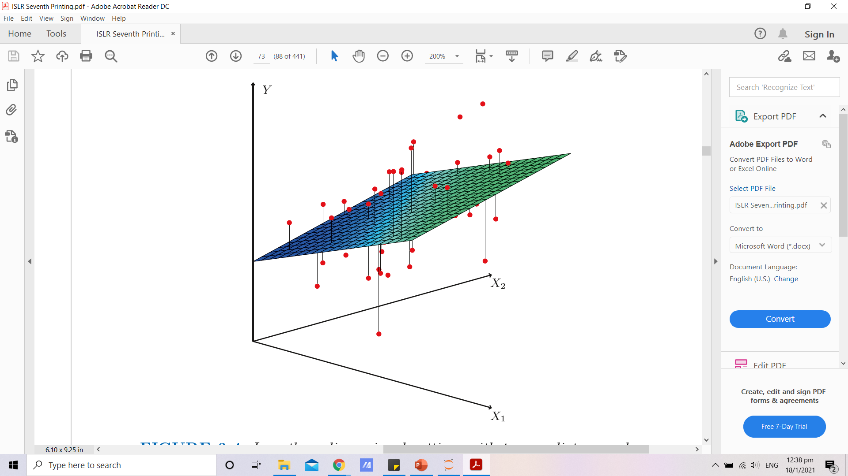
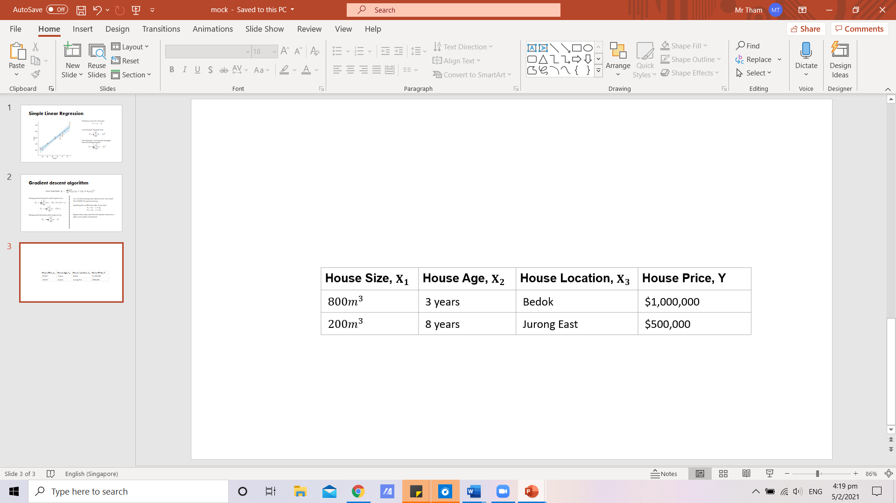
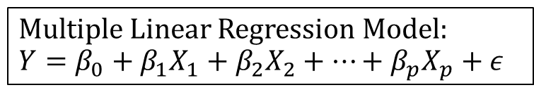
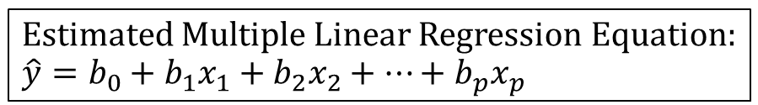
Multiple Variable Linear Regression
An extension of simple linear regression where 2 or more predictor variables are used to predict the variance of one response variable
Source: An Introduction to Statistical Learning: With Applications in R

Slide 20
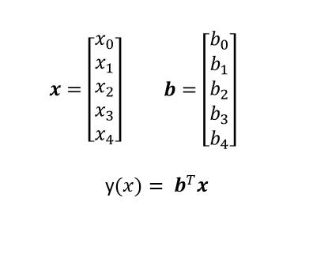
Vectorization
Why Vectorize?
Using for-loops in Python is slow
Vectorized code use highly optimised linear algebra libraries
Matrix multiplication is very fast on Graphics Processing Unit (GPU)

Slide 21
Potential Issues With Multivariate Linear Regression
2 problems may arise:
Overfitting: having too many predictor variables that account for more variance but do not add value to the model
Multicollinearity: some predictor variables are correlated with each other and it becomes difficult to identify which variable is actually used in predictions
The ideal is for all predictor variables to be correlated with the response variables but not with each other

Slide 22
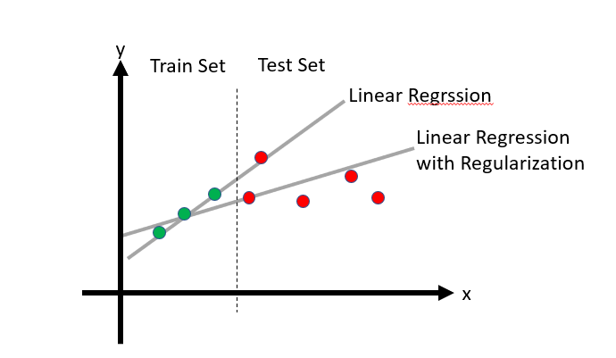
Regularization
A technique used to tune the model by adding an additional penalty term in the error function (reducing the weights and bias) to overcome overfitting, making the model less sensitive to variations in independent variables

Slide 23
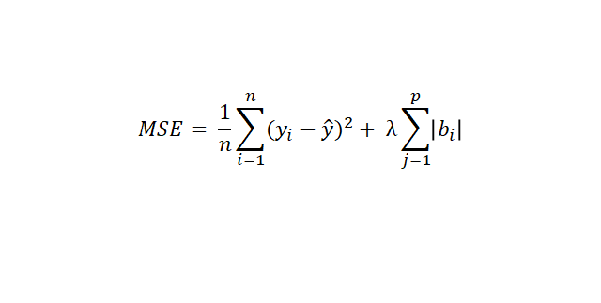
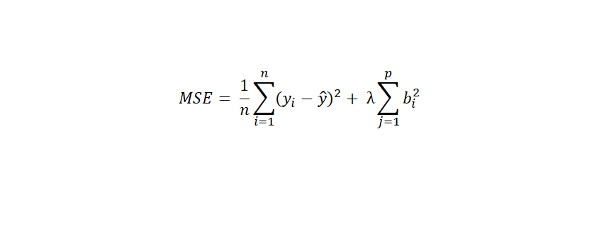
Regularization
Linear Model:
Lasso Regression
Uses absolute value as a penalty term
Particularly useful for feature selection
Can reduce slope to exactly zero
Ridge Regression
Uses squared value as a penalty term
Can reduce slope close to zero but not exactly zero

Slide 24
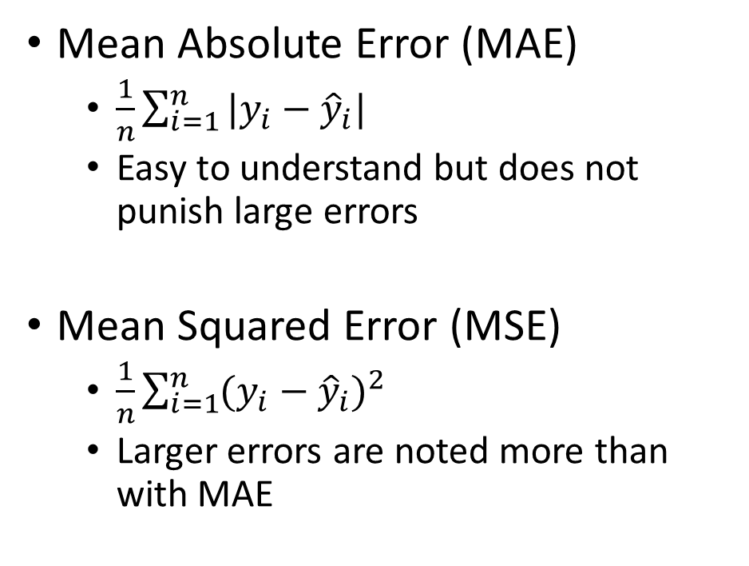
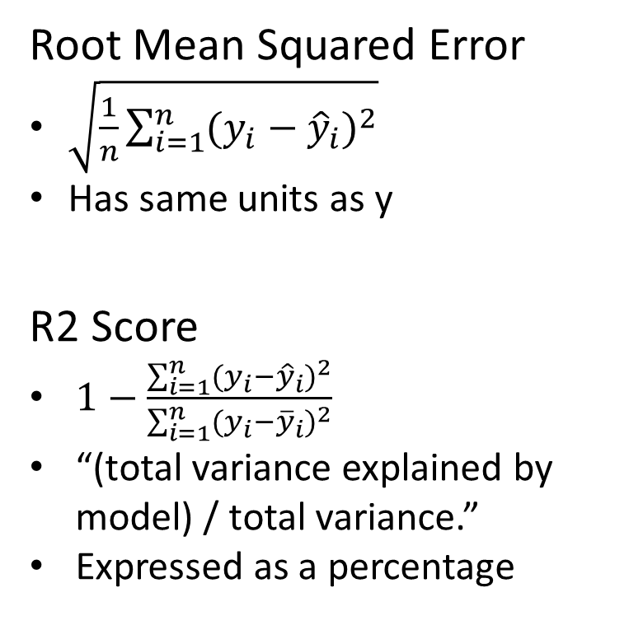
Evaluation Metrics for Linear Regression
Evaluation of error should consider context!
Notes:
Context of house price vs candy bar price when u have a rmse of $10

Slide 25
Pop Quiz
What is regularization important in training your model?
A. Because the data has to be regular in size
B. Avoid overfitting
C. To make your model more lightweight
D. To add more terms in the lost function

Slide 26
Feature Engineering

Slide 27
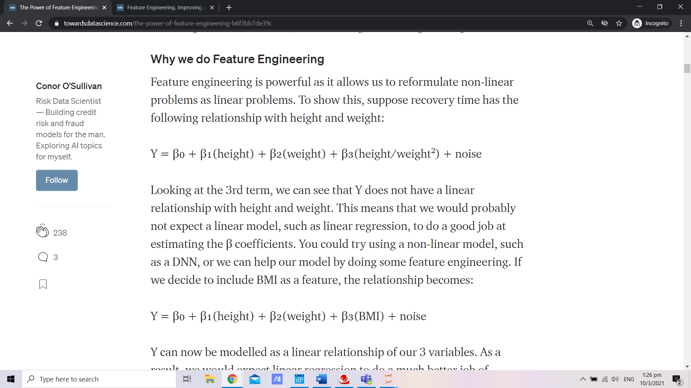
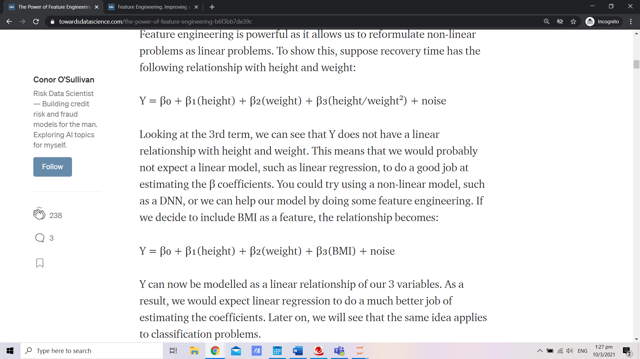
Feature Engineering
Creating features from raw data or adding functions of your existing features to your dataset
What
Why
Allows us to reformulate non-linear problems as linear problems
How
→ Bivariate Combinations
→ Polynomials
→ Mathematical transformations
→ Dummy Variable Encoding
Example
Before
After
Notes:
Context of house price vs candy bar price when u have a rmse of $10

Slide 28
Demo in Notebook
2 Examples:
Log transform
Dummy variable encoding

Slide 29
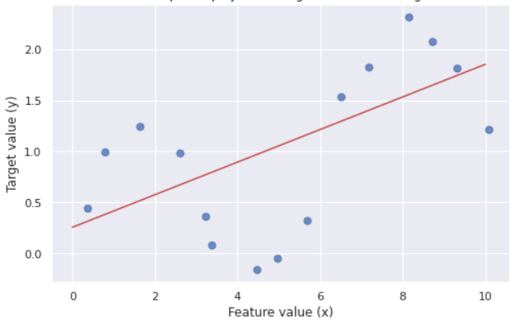
Polynomial Regression
What about this set of data?
In fact, R2-score < 0 does no follow trend ie. worse than horizontal straight line

Slide 30
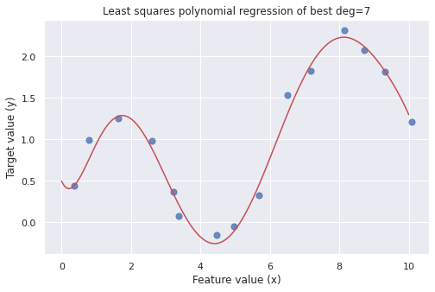
A better line of best fit

Slide 31
Polynomial Regression
Linear features: y = mx + c = m(x) + c(1) -> Features: [1, x]
Polynomial features: (Eg. 2nd degree)
We only have x0 x1 …
For x0: 1, x0, x0²
For x0, x1: 1, x0, x1, x0x1, x0², x1²
Hence if its one-variable only, p(x) = a_0 + a_1*x + a_2*x^2 + ...
We add more columns of data
x | p(x) | x | x^2 | x^3 | ...
1 | -3 | 1 | 1 | 1 | ...
2 | 0 | 2 | 4 | 8 | ...
Demo!

Slide 32
Overfitting Note
What happens beyond the limits of the x i.e. new data?

Slide 33
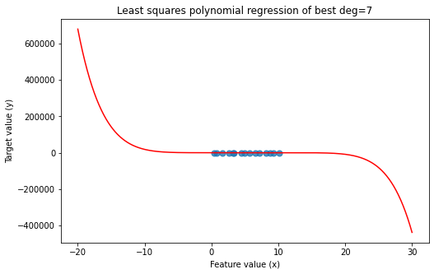
Overfitting Note
What happens beyond the limits of the x i.e. new data?
Might not be such a good idea to fit to the best curve …
Countermeasures learned in next few workshops
-> How to reduce overfitting

Slide 34
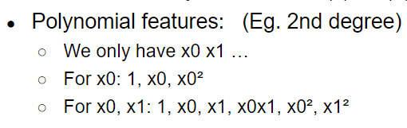
Pop Quiz
If a polynomial regression of degree 2 is fitted onto a dataset with 2 independent variables and 1 output, how many features will this model have?
A. 12 B. 6 C. 5 D. 2

Slide 35
Logistic Regression

Slide 36
Regression vs Classification
Regression Problem
Input variable and the output variable are both continuous variables
Classification Problem
Output variable is a finite number of discrete variables

Slide 37
Logistic Regression
A classification model, usually binary classification
Loved for its simplicity, parallelization, and strong interpretability
Why is it called logistic regression then?
→ Underlying mechanism is still linear regression with 1 change

Slide 38
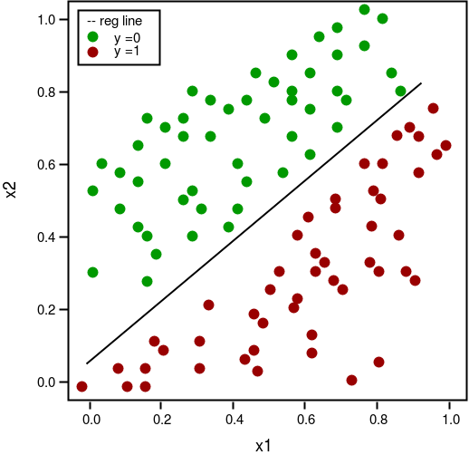
Decision Boundary
Every point lying on the left/top of the line will be predicted as ‘1’
‘0’ for the other side of the line
How to find the decision boundary?
‘Curvy’ boundary - needs feature engineering

Slide 39
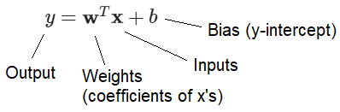
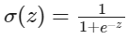
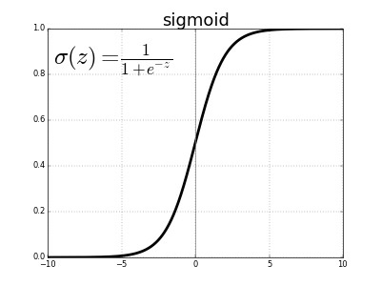
Sigmoid/Logistic Function
Also called ‘activation function’
w is a normal vector of the hyperplane that is the decision boundary

Slide 40
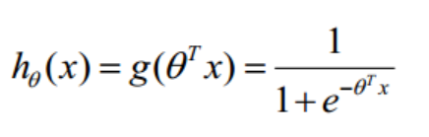
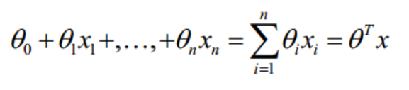
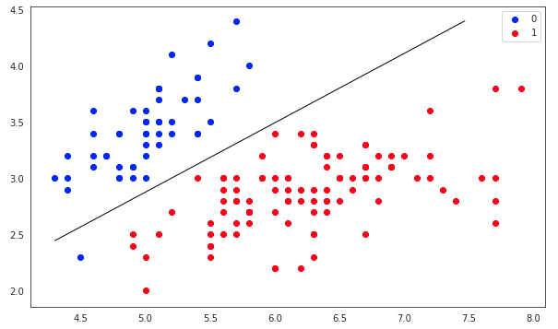
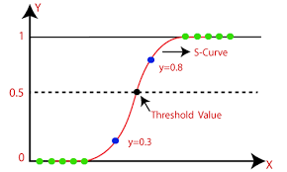

Slide 41
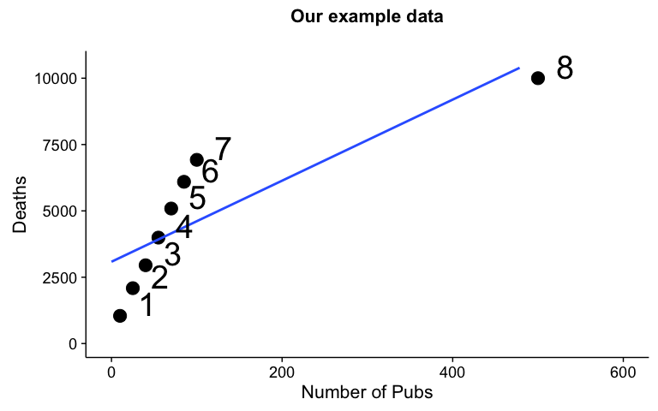
Why not linear regression only?
Different problems - regression vs classification
Line of best fit is sensitive to outliers

Slide 42
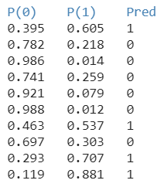
Binary Classification
There is only two state of the outputs:
→ 1 or 0
The model regresses for the probabilities of a categorical outcome.

Slide 43
Pop Quiz
Why is the sigmoid function so important in logistic regression?
A. To engineer features of the model so that it will bounded between 0 to 1 for probability calculations
B. To squash the output of the model to [0, 1] so that outliers don’t affect the decision boundary by a lot
An example to predict whether an outcome of ‘0’ or ‘1’ was used earlier. This is known as “binary classification”. Can logistic regression be used then to predict more than two classes i.e. multiclass classification. (Yes/No)

Slide 44
Logistic Regression Pipeline
Find the h function (hypothesis)
Find the loss function
Apply gradient descent method using the derivative of the loss function

Slide 45
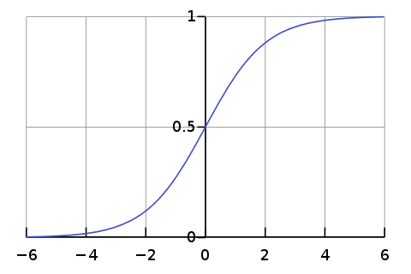
Hypothesis

Slide 46
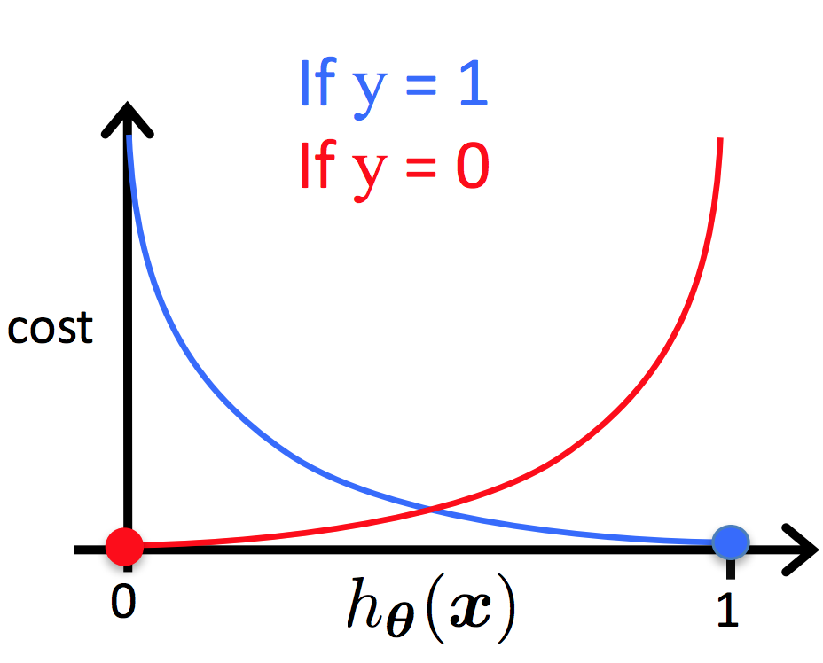
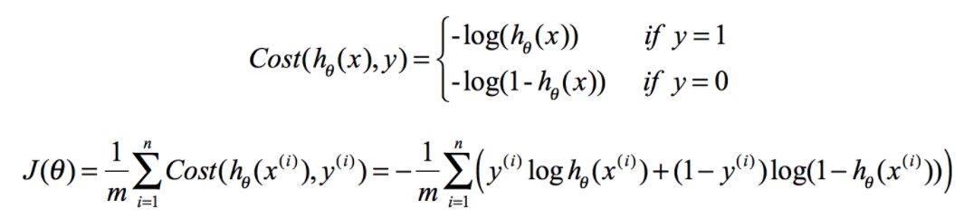
Loss function
The more ‘wrong’ the prediction, penalise it more heavily.
Just understand how ...
m
m
Notes:
correct n → m

Slide 47
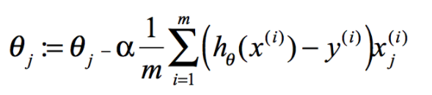
Apply gradient descent method
Update the weights using the gradient descent method with the formula below. Iterate till the loss converges to a minma

Slide 48
Pop Quiz
There is a false positive (0 label predicted as 1) and the h function outputs a number close to 0.9 for this data point.
How does this data point affect the overall cost?
A. It increases the cost by a lot.
B. It decreases the cost by a lot.
C. There is no change to the cost.

Slide 49
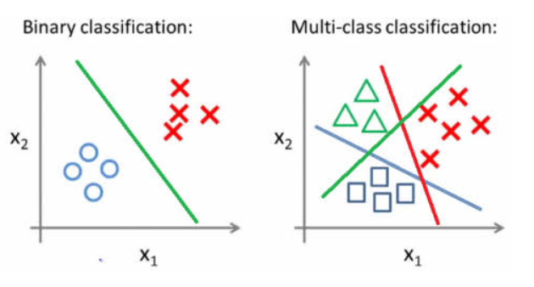
Multi-class Classification - Two Main Approaches

Slide 50
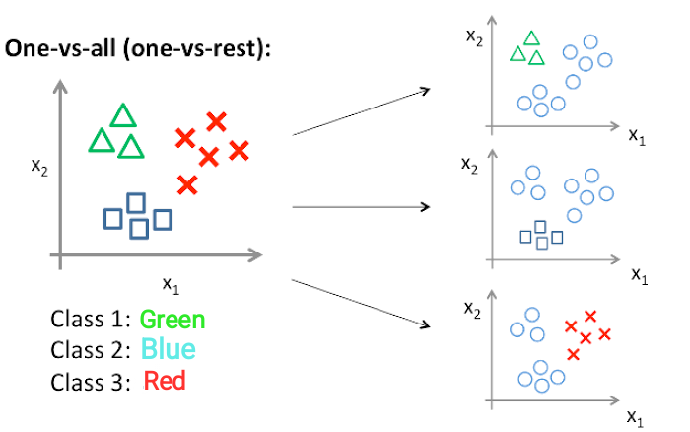
Multi-class Classification - One-vs-all
Classifier 1: [Green] vs [Red, Blue] Classifier 2: [Blue] vs [Green, Red]
Classifier 3: [Red] vs [Blue, Green]

Slide 51
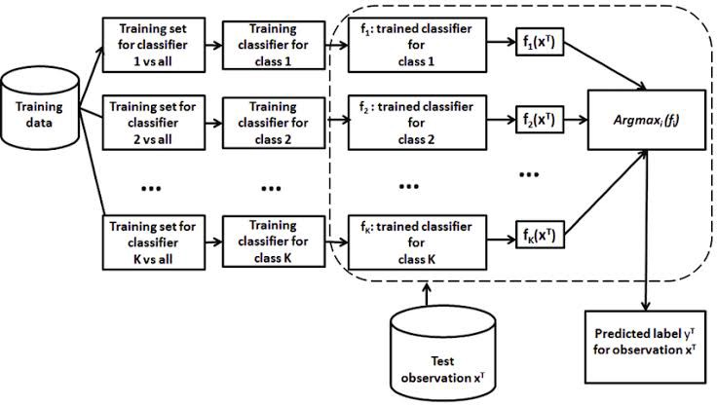

Slide 52
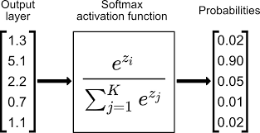
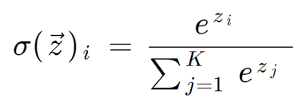
Multi-class Classification - Multinomial
Also used in neural networks!

Slide 53
Thank you! | Q & A

Slide 54
Yong Hao TH0001AO@e.ntu.edu.sg Philip PLEE016@e.ntu.edu.sg Wai Yeong WLEE086@e.ntu.edu.sg
Contact us for any questions

Slide 55

We Value Your Feedback!
https://forms.gle/Lkk76wWcDVJewgQK7

